Slide 1
Advanced Design Patterns for Amazon DynamoDB

Slide 2
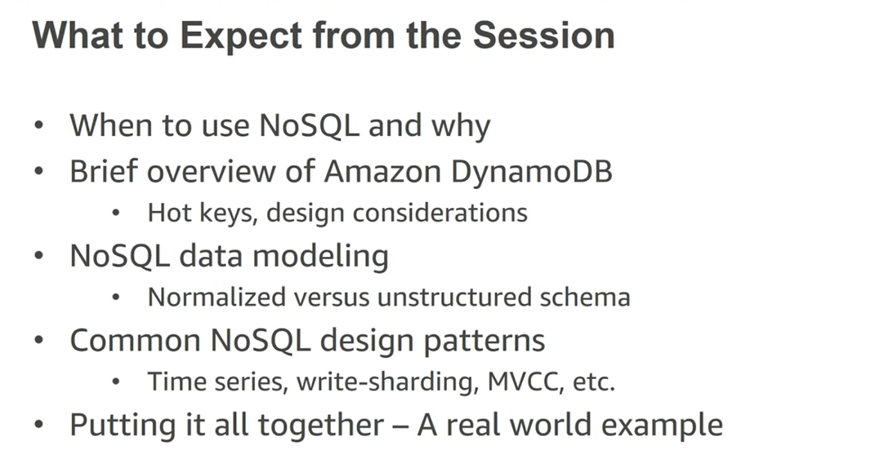

Slide 3
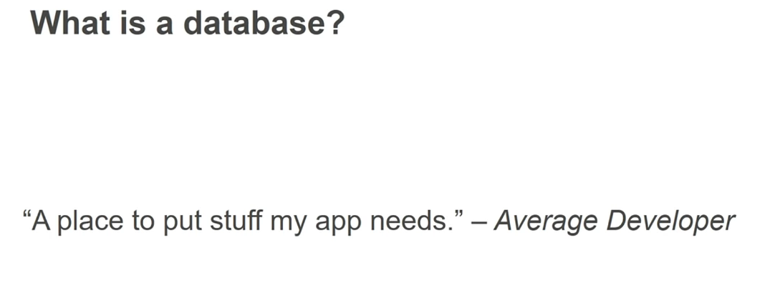

Slide 4
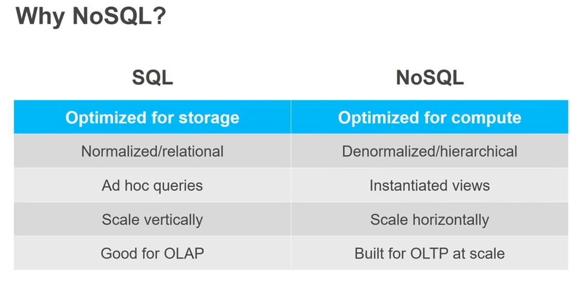

Slide 5
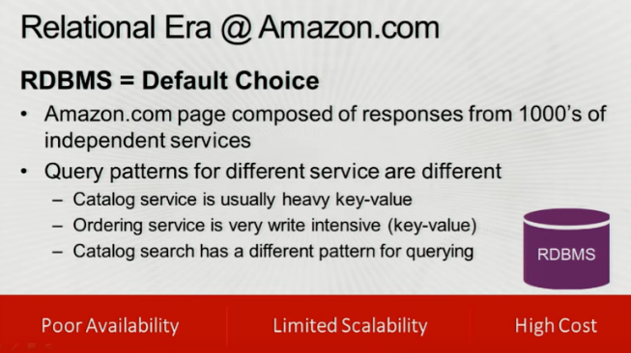

Slide 6

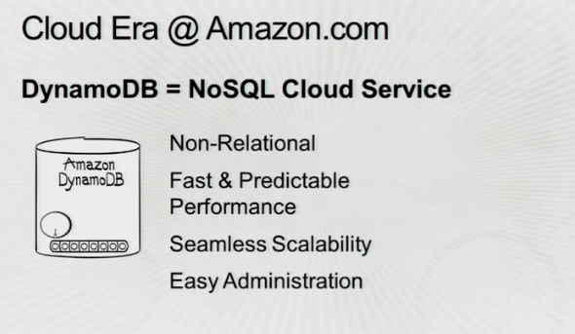

Slide 7
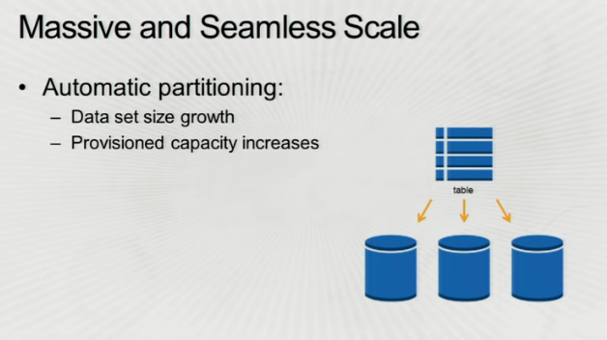

Slide 8


Slide 9
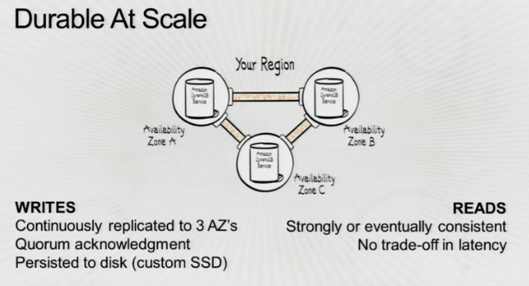

Slide 10


Slide 11
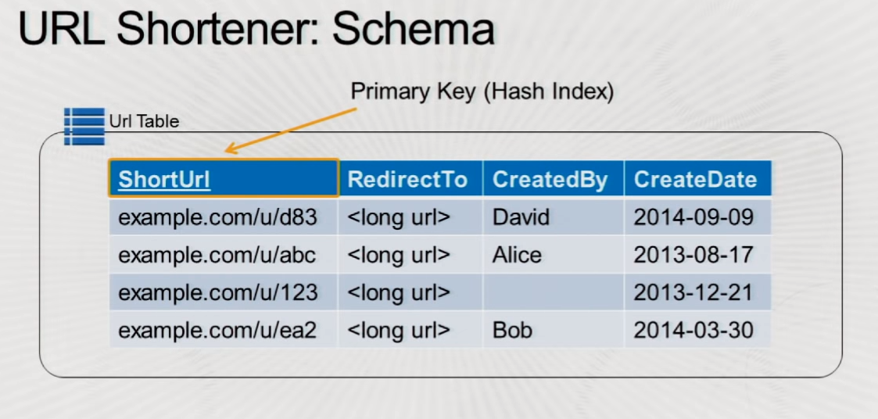

Slide 12
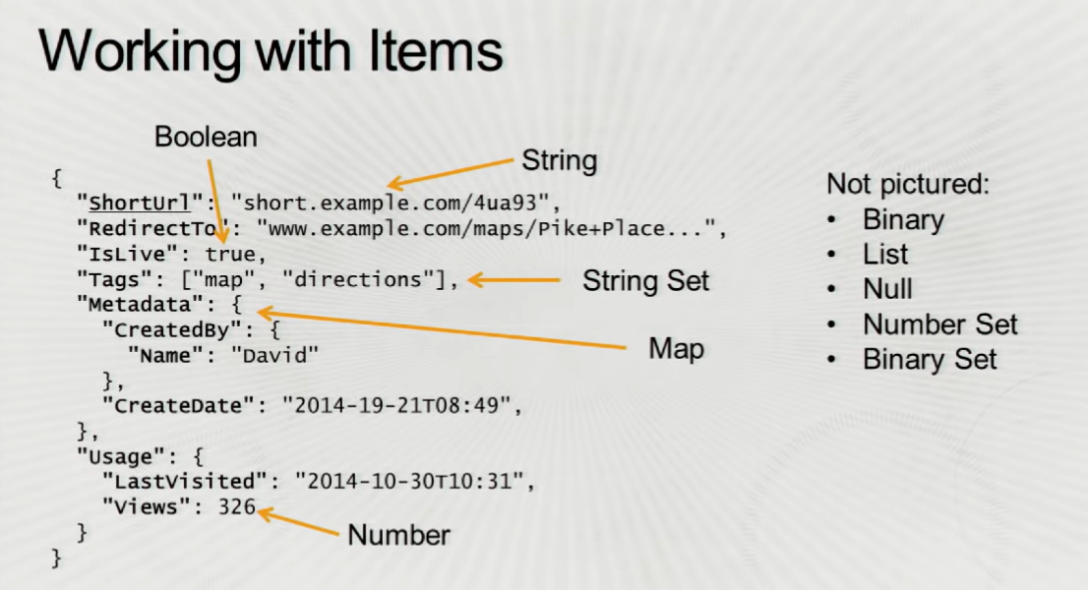

Slide 13
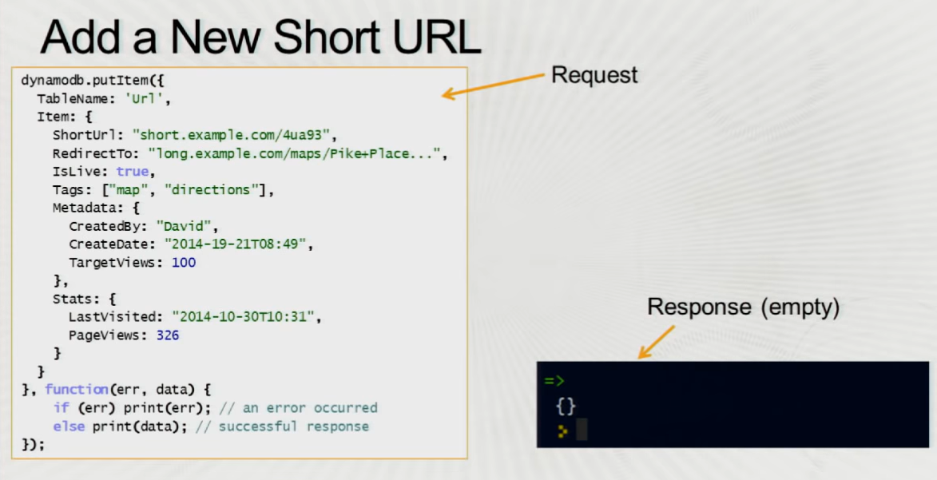

Slide 14
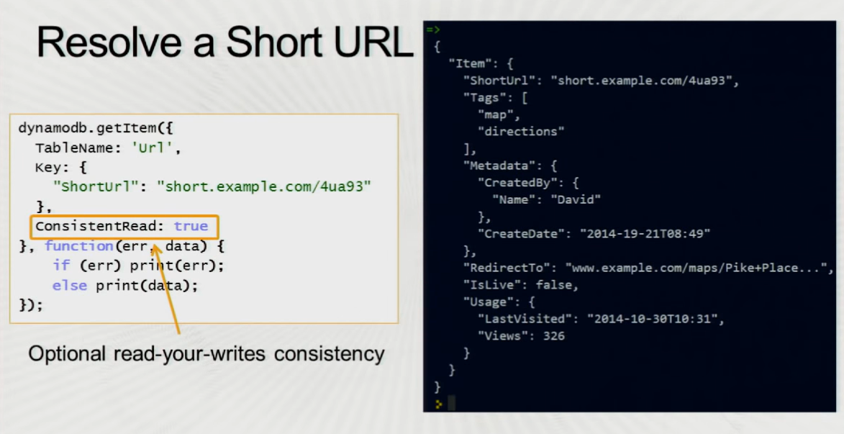

Slide 15
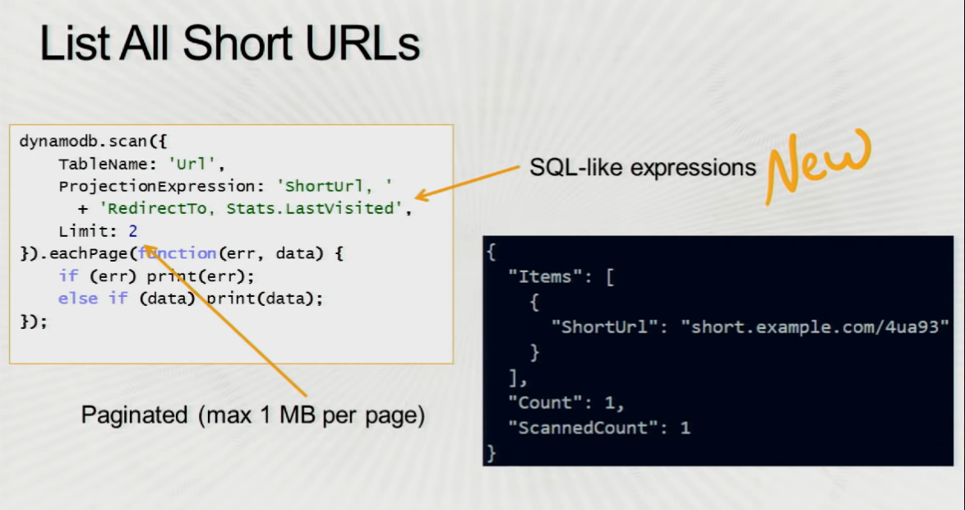

Slide 16
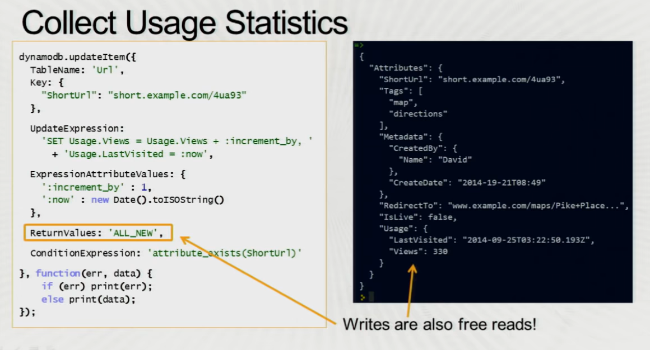

Slide 17
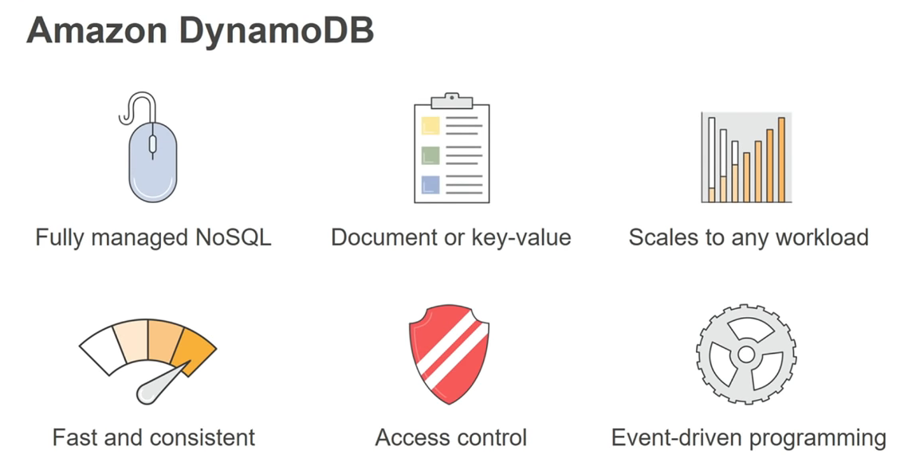

Slide 18
Partition Key → uniquely identifies logical partition on the storate node.
Sort Key → uniquely identifies items within logical partition.

Slide 19
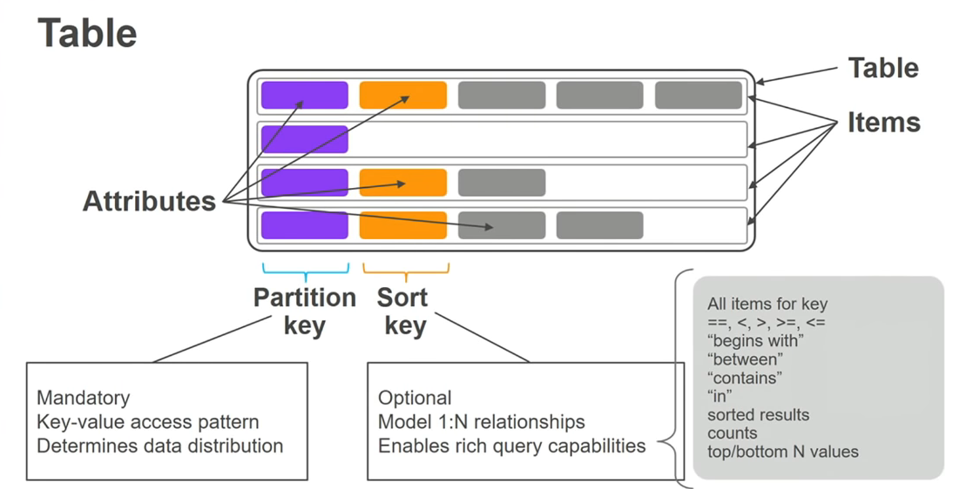

Slide 20
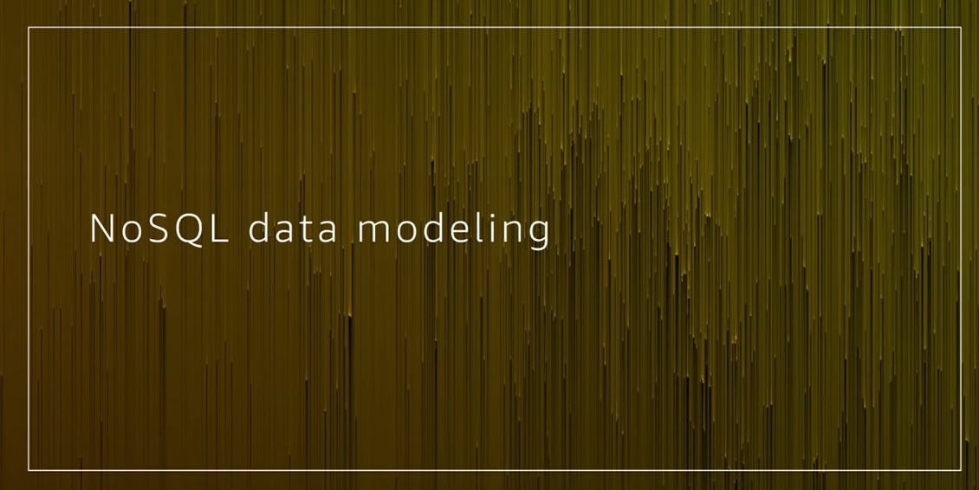

Slide 21
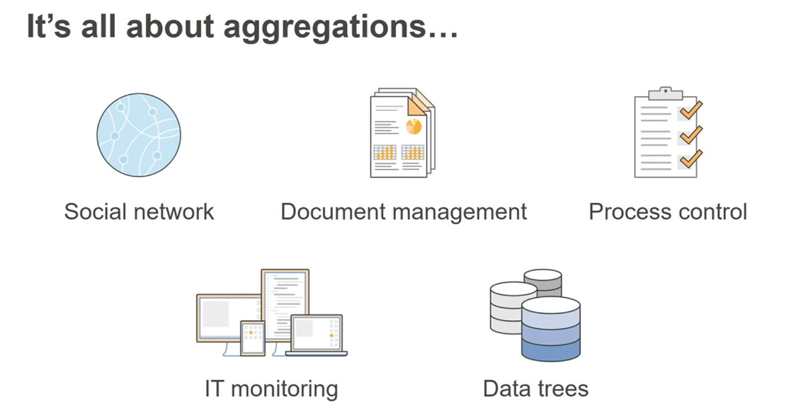

Slide 22
Back then (3 decades may be) disk is expensive and cpu is cheap. So RDBMS data modelling worked well but now the scenario is reversed.
So No-SQL data modelling paved a way

Slide 23
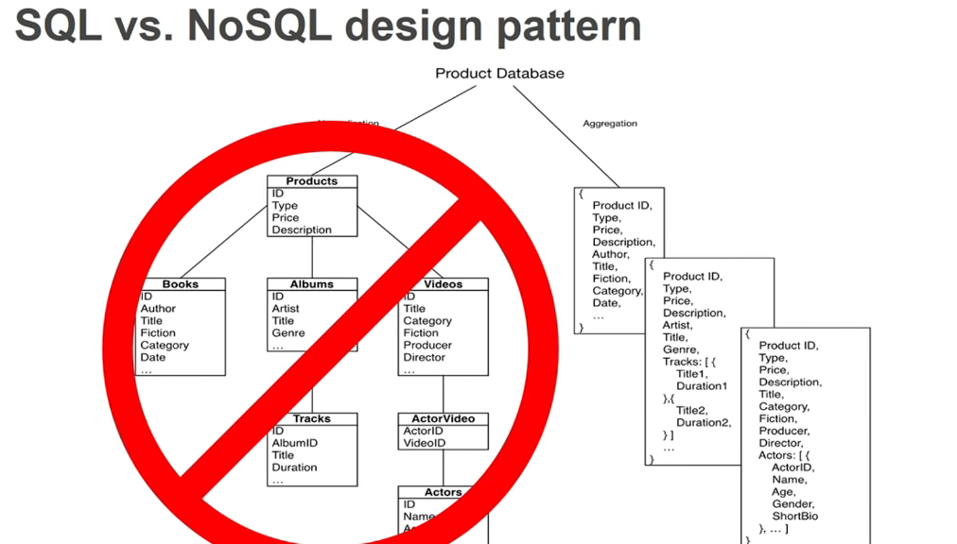

Slide 24


Slide 25
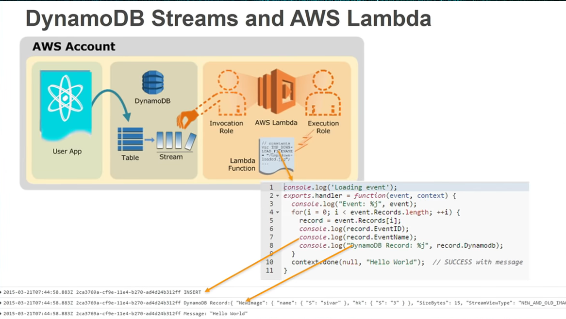

Slide 26
Streams is the changelog for Dynamodb table.
All write operations will go into the stream and can be hooked up by Lambda.
You can take this stream as a stored procedure engine for DynamoDB
As writes occur on table, lambda function creates and maintains this running aggregations, pushes the data result set back into the table as metadata items.
We can also update, alert third party systems with lambda.

Slide 27
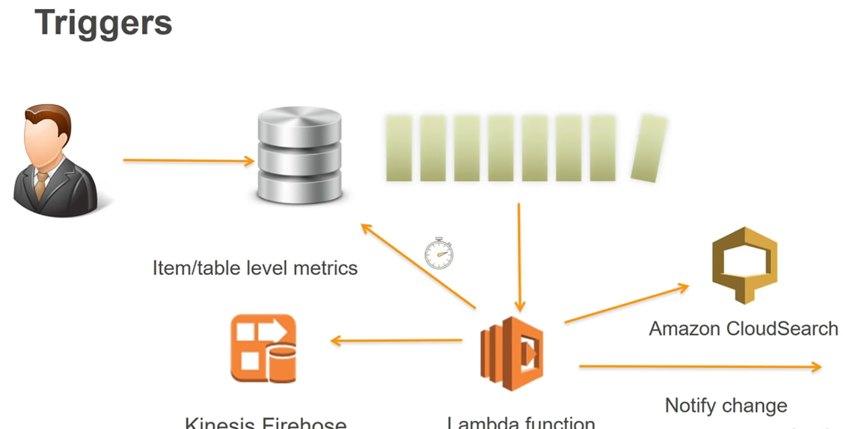

Slide 28
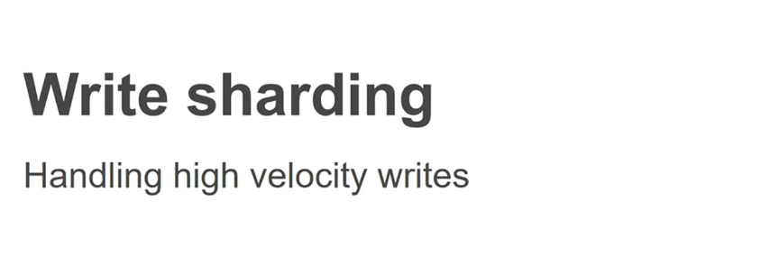

Slide 29
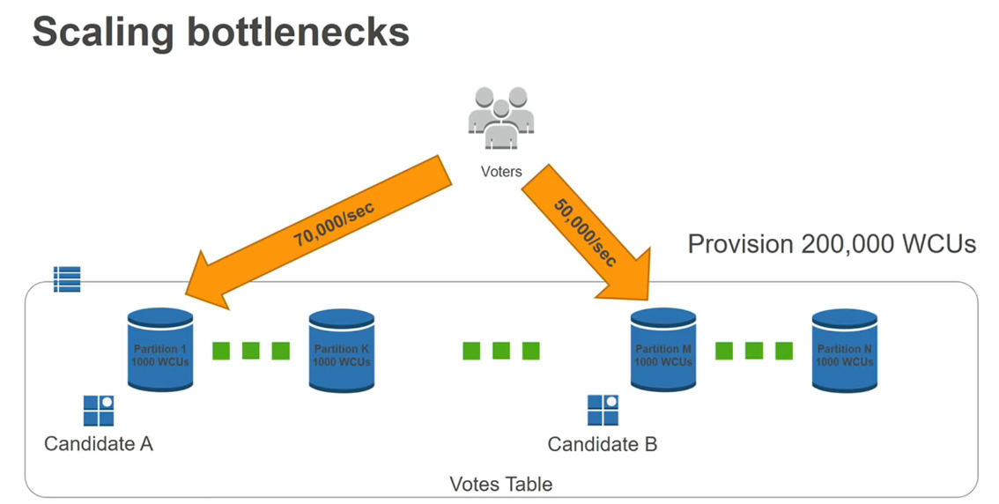

Slide 30
In DynamoDB we get certain capacity per storage partition (usually 1000 WCUs – 3000 WCUs).
If we exceed that capacity we get throttled.

Slide 31
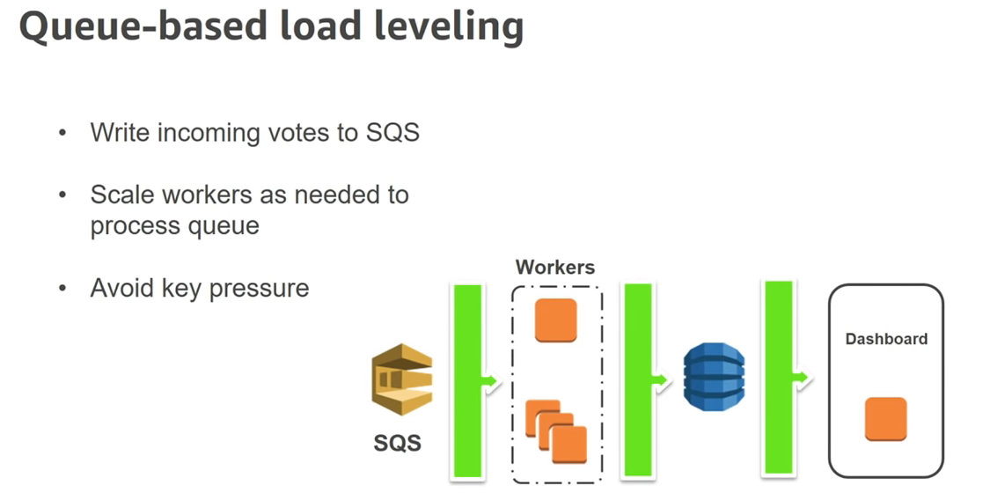
This is great but cannot provide us real time aggregations specially if your data is queued and waiting for processing.

Slide 32
If we partition data then it’s like threading and Dynamo DB scales linearly across threads. Single thread performance in dynamo is not that great because it’s a REST API and every request we make is forming a connection so threading is good to magnify the throughput.
We can run with millions of threads with ease in dynamodb.
Partition by random int usually declares random threads
partition by hashed value can be used to access that particular records destination using that hashed value

Slide 33
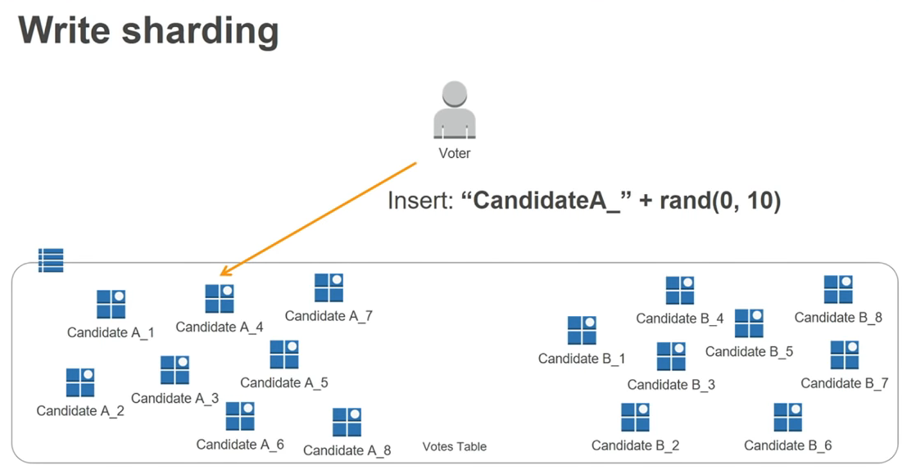

Slide 34
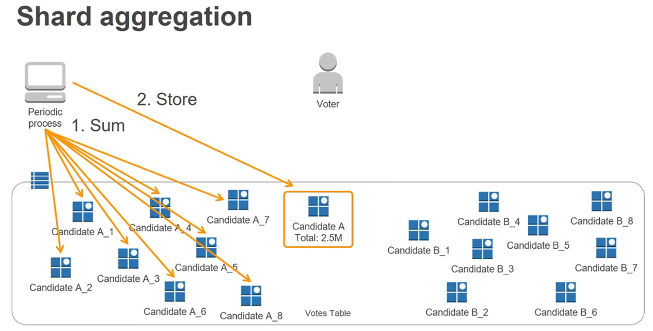

Slide 35
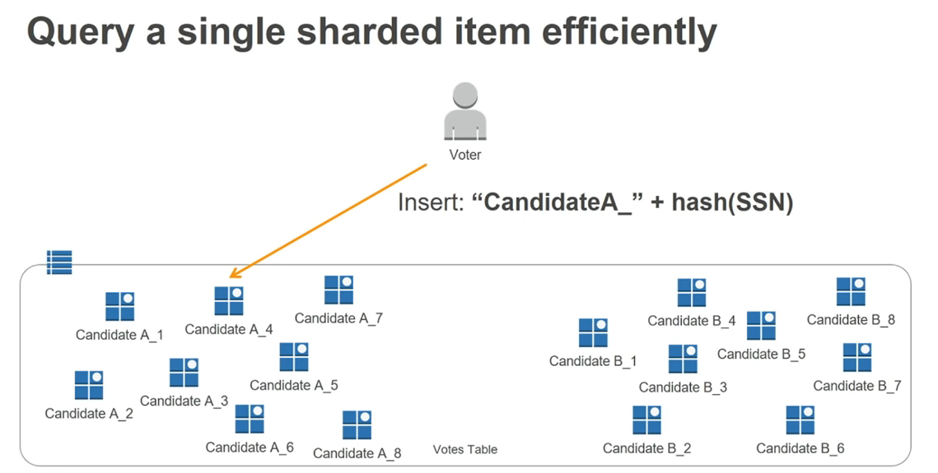

Slide 36
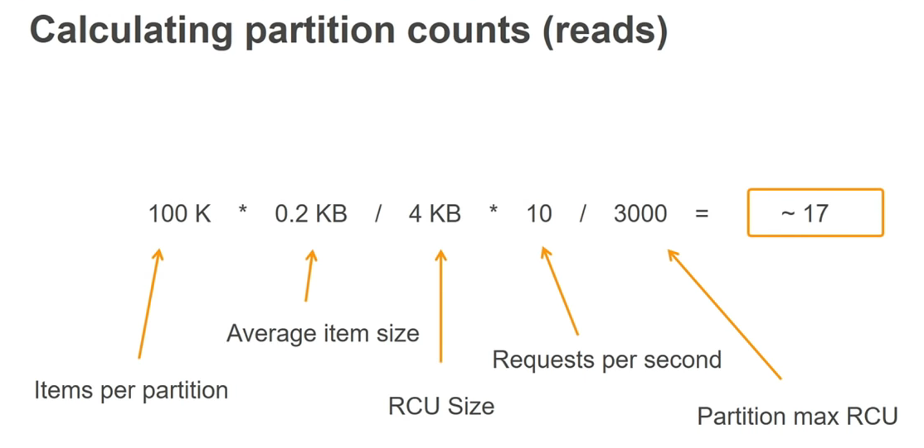

Slide 37
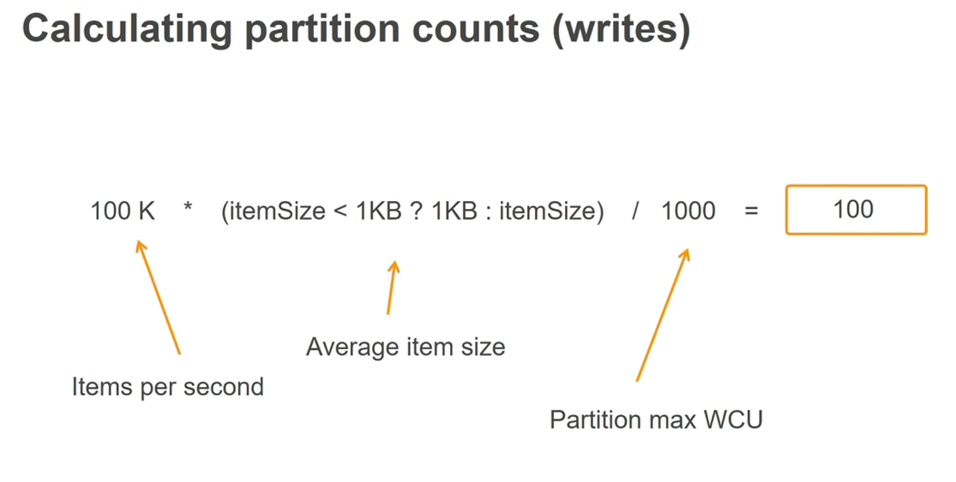

Slide 38
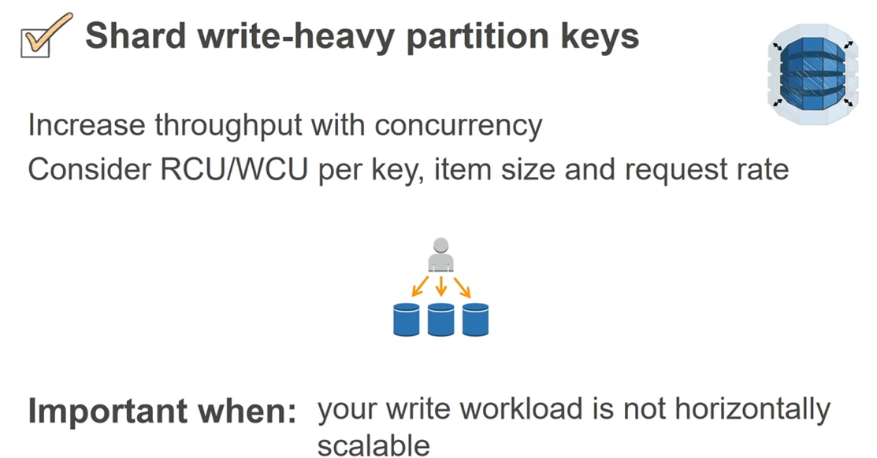

Slide 39
